Slide 1
Pronoun expansion in the history of Russian:
The starting point
Evgeniya Budennaya
Institute of Linguistics RAS
jane.sdrv@gmail.com

Slide 2
Typological overview
2 main patterns of reduced subject marking: personal pronouns VS verbal affixes
Verbal affixes: the most widespread pattern (61% of modern languages [WALS] + all ancient IE languages)
(1) Czech:
  Vrátí-m se brzy
  come.back.PRS-1SG REFL скоро
  ‘I will come back soon’
(2) Latin:
  Dum spir-o sper-o
  while breathe.PRS-1SG hope.PRS-1SG
  ‘While I breathe, I hope’
Personal pronouns: only 14% of languages [WALS]
(3) English:
Now I need a place to hide away

Slide 3
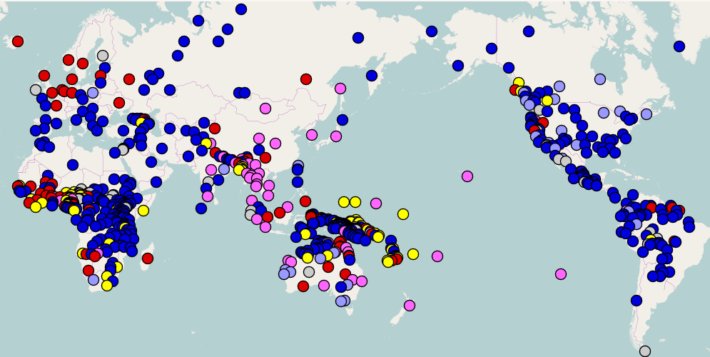
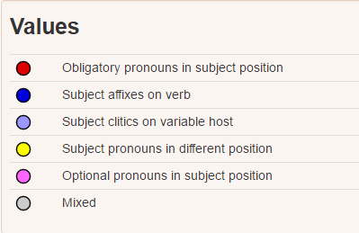
WALS 2013: cross-linguistic context
Russian

Slide 4
Russian: from affixes to personal pronouns
Old Russian (before XIII): personal pronouns are hardly ever employed in non-emphatic contexts
(4) Novgorod birch-bark letter 644, early XIIs:
  čemoy ne vosol-eši
  why not send.back-PRS.2SG
  četo t-i jes-emo voda-l-a kova-ti
  what you-DAT be.PRS-1SG give-PTCP-FSG forge-INF
  ‘Why do not you send me back what I gave you for forging?”
Modern Russian: personal pronouns are used in over 70% of occurrences [Kibrik 1996; Seo 2001]
(5) Novgorod birch-bark letter 644, modern translation [Zalizniak 2004: 267]:
    pochemu ty ne prisylaeš to, chto ja dala tebe vykovat‘?
    ‘Why do not you send me back what I gave you to forge?”
What caused such a striking pronoun expansion?

Slide 5
“Perfect-copula-drop” hypothesis
A common explanation: pronoun expansion as a result of perfect copular loss in verbal clauses [Jakobson 1971/1935: 21; Borkovskij 1968: 50; Lindseth 1998: 65; Kibrik 2004; Meyer 2011: 131]
Based on the fact that even in the earliest texts the 3rd person auxiliary was mostly dropped
A particular case of verb impoverishment which is a typologically widespread phenomenon [Kibrik 2011: 271]
 |  | Proto East Slavic (before 11th century) | Early Old Russian (11th -13th centuries) | Modern Russian
Verbal Perfect/Past | 1Sg.M 3Sg.M | Perfect dal-ъ jesmь ‘I gave’ dal-ъ jestь ‘he gave’ | Perfect>New past dal-ъ jesmь ‘I gave’ dal-ъ Ø_{cop}‘he gave’ | New Past ja dal ‘I gave’ on dal ‘he gave’

Slide 6
Objections
Over 3-centuries time gap between 3rd person copular loss in verbal clauses and the significant rise or unmarked personal pronouns
Personal pronouns in past verbal clauses expanded significantly in the 16th – 17th centuries – while the 3rd person copula was lost as far back as in 12th century [Khaburgajev 1978: 46; Zalizniak 2008: 247; Meyer 2011: 130]
3rd person zero copula is cross-linguistically common indeed but the tendency towards 1st and 2nd copula drop is much less known
E.g. 3rd person zero in Czech and Polish from the 15th century onwards [Andersen 1987: 28; Skorvid 2005: 236] but no cues found for any further verbal reconstruction

Slide 7
Clauses with a nominal predicate: do they behave the same way?
As well as past verbal clauses, the clauses with a nominal predicate (=nominal clauses) were also affected by pronoun expansion
But they still remain unstudied on a large scale
Most researchers either do not evoke nominal clauses at all or just mention them together with verbal clauses [Jakobson 1971/1935: 71]
But no separate study of nominal clauses was ever conducted => we cannot be exactly sure that they follow exactly the same path as verbal clauses from a diachronic perspective
 |  | Early Old Russian (before 12th century) | Modern Russian
Nominal present | 1Sg.M 3Sg.M | vinovat-ъ jesmь ‘I am guilty’ vinovat-ъ jestь ‘he is guilty’ | ja Ø_{cop} vinovat on Ø_{cop} vinovat

Slide 8
The analysis: main principles
Texts from 11th till 2nd half of 17th century
  2nd half of 17th century: “referential marking is nearly the same as in modern Russian” [Zaliznjak 2008: 256.; Chernykh 1952: 227; Borkovsky, Kuznetsov 2006: 323; Kibrik 2013: 236]
Non-literary register (birchbark letters, official documents, domestic and foreign policy contracts)
Sources: Russian National Corpus (historic part) http://ruscorpora.ru/old; e-library “Vostochnaja literatura” (‘Eastern literature’ – documents and acts from 11th till 17th century, online at http://www.vostlit.info )
1st-2nd VS 3rd person pronouns
Types of patterns analyzed: zero pronoun clauses (both with and without a copula); zero copula clauses (both with and without a subject pronoun); double-marking patterns with both a subject pronoun and a verb copula
Overall volume: nearly 1000 relevant clauses extracted from texts
Methodology: manual data extraction with later statistical processing in SPSS (binominal and χ-square tests, Student’s t-test)

Slide 9
Results-1
Significant chronological difference on the very first evolutional stage between nominal and pars verbal clauses
The massive loss of 3rd person auxiliary in nominal clauses succeeded the same process in verbal clauses
 |  | Proto-Old Russian (before the 11th century) | Early Old Russian (11th -12th centuries) | Middle Russian (13th -14th centuries)
Verbal perfect | 1Sg.M 3Sg.M | dal-ъ jesmь dal-ъ jestь | dal-ъ jesmь dal-ъ Ø_{cop} | dal-ъ jesmь dal-ъ Ø_{cop}
Nominal | 1Sg.M 3Sg.M | vinovat-ъ jesmь vinovat-ъ jestь | vinovat-ъ jesmь vinovat-ъ jestь | vinovat-ъ jesmь vinovat-ъ Ø_{cop}

Slide 10
Results-2
And only after a copular loss in nominal clauses pronoun expansion took place (firstly 3rd person pronouns replaced zero markers; approximately a century and a half later 1st and 2nd person pronouns followed them):
 |  | 11th -12th | 13th -1st half of 14th | 2nd half of 14th – 15th | 16th-1st half of 17th
Verbal perfect/ past | 1Sg.M 3Sg.M | dal-ъ jesmь dal-ъ Ø_{cop} | dal-ъ jesmь dal-ъ Ø_{cop} | dal-ъ jesmь on dal-ъ | ja dal-ъ on dal-ъ
Nominal | 1Sg.M 3Sg.M | vinovat-ъ jesmь vinovat-ъ jestь | vinovat-ъ jesmь vinovat-ъ Ø_{cop} | vinovat-ъ jesmь on vinovat-ъ | ja vinovat-ъ on vinovat-ъ

Slide 11
Conclusion
It appears that only a double loss of 3rd person auxiliary (both in verbal and in nominal clauses) could trigger some further referential alignment
Single 3rd person zero in verbal clauses cannot provoke such an evolution
Czech and Polish: 3rd person zero in verbal clauses but an overt copula in nominal clauses => no Russian-like pronoun rise
(8) Polish vs Russian:
  Nie Ø_{pro} jest szaleńcem ani samobójcą. Dlaczego Ø_{pro} tak ryzykował? (PO)
  On ne Ø_{cop} sumasšedshij i ne samoubijca. Začem on tak riskoval? (RU)
  ‘He is neither insane nor suicidal. Why did he risk so much?’
  http://ruscorpora.ru/search-para-pl.html
So the fall of copulas in nominal clauses could be acknowledged as the starting point for further referential reconstruction
Missing link probably found?..

Slide 12
References
Борковский, Кузнецов 2006 – Борковский В. И., Кузнецов П. С. Историческая грамматика русского языка. М.: КомКнига, 2006.
Зализняк 2004 – Зализняк А. А. Древненовгородский диалект. М.: ЯСК, 2004
Зализняк 2008 – Зализняк А. А. Древнерусские энклитики. М.: ЯСК, 2008.
Хабургаев 1978 – Хабургаев Г.А. Судьба вспомогательного глагола древних славянских аналитических форм в русском языке. // Вестник МГУ, сер. 9 (филология), 1978. № 4. С. 42-53.
Jakobson 1971/1935 – Jakobson R. Les enclitiques slaves. Selected Writings, Vol. II. The Hague: Mouton, 1971. Pp. 16-22. (Original publication: Atti del Congresso di Linguistica tenuto in Roma il 19-26 Settembre 1933. Firenze, 1935)
Kibrik 1996 – Kibrik, Andrej A. Anaphora in Russian narrative prose: A cognitive calculative account. Fox B. A. (ed.). Studies in Anaphora. Amsterdam: John Benjamins, 1996. Pp. 266–303.
Kibrik 2004 – Kibrik, Andrej A. Zero anaphora vs. zero person marking in Slavic: A chicken/egg dilemma? In Branco A., Mitkov R., McEnery T. (eds.), Proceedings of the 5th Discourse Anaphora and Anaphor Resolution Colloquium (DAARC). Lisbon: Edicoes Colibri, 2004. Pp. 87–90.
Kibrik 2011 – Kibrik Andrej A. Reference in discourse. Oxford: Oxford University Press, 2011.
Lindseth 1998 – Lindseth M. Null-subject properties of Slavic languages: with special reference to Russian, Czech and Sorbian. München: Sagner, 1998.
Meyer 2011 – Meyer R. The History of Null Subjects in North Slavonic (A Corpus-based Diachronic Investigation). Habilitation Thesis. Regensburg: University of Regensburg, 2011.

Slide 13
Thanks for watching! ☺

